Slide 1
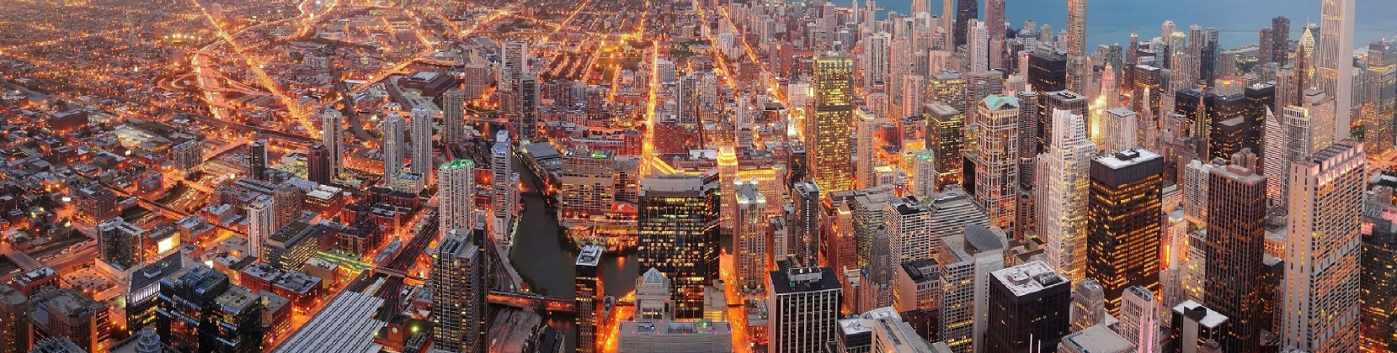



I L L I N O I S
Interdiction And Restoration Of Interdependent Infrastructure Systems
in Military Operations
Liqun Lu, Zhaodong Wang, Dr. Yanfeng Ouyang
Nov. 15th, 2016
INFORMS 2016 Annual Meeting

Slide 2
Outline
Background
Methodology
Infrastructure interdependency model
Interdiction and restoration optimization
Solution Algorithm
Cutting plane algorithm
Two-stage genetic algorithm
Case Study
Conclusion

Slide 3
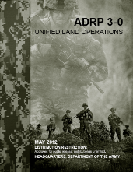
Military Doctrine
Landpower is the ability—by threat, force, or occupation—to gain, sustain, and exploit control over land, resources, and people.
Landpower includes the ability to—
Impose the Nation’s will on an enemy, by force if necessary.
Engage to influence, shape, prevent, and deter in an operational environment.
Establish and maintain a stable environment that sets the conditions for political and economic development.
Address the consequences of catastrophic events—both natural and man-made—to restore infrastructure and reestablish basic civil services.
Support and provide a base from which joint forces can influence and dominate the air and maritime domains of an operational environment.
(Dr. Steve Hart, USMA)
Notes:
First off, here is a slide from a West Point professor, about the military operation doctrine. It talks about the concept of landpower, which is the ability to gain, sustain, and exploit control over land, resources, and people. I want to emphasize some of its components. Those are, the ability to…

Slide 4
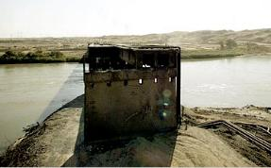
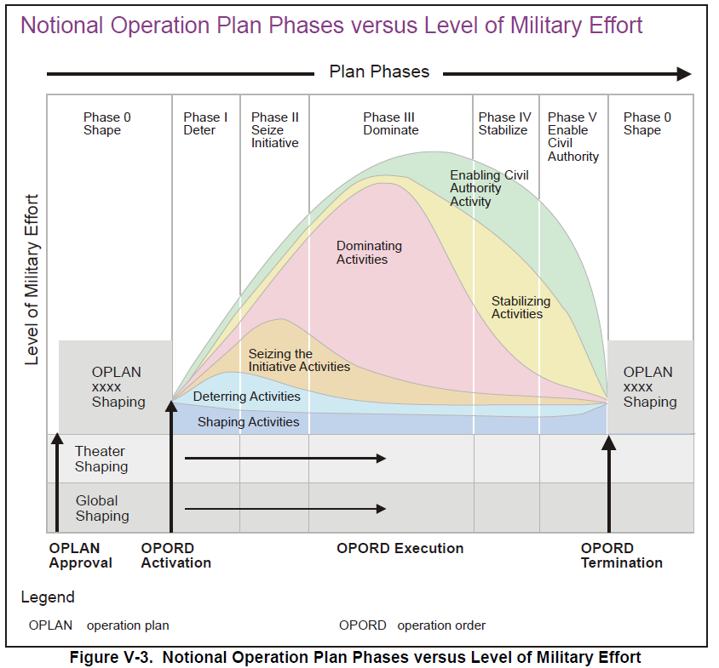
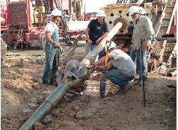
Military Operation Art
SMART
Break it bad
Fix it Fast
(Dr. Steve Hart, USMA)
Notes:
Coming to practice from the philosophy, this figure shows offense military operation plan phases versus level of effort. In Phase II and III, the military needs to seize initiative by destroying some of the enemy’s infrastructures and then dominate the enemy’s territory, we call it break it bad. After the offense military takes control over the region, it now needs to stabilize its control by rebuilding the damaged infrastructure system so as to provide sufficient resources to the civilians. This task is call fix it fast. However, in the past military operations, the interdiction of infrastructure did not take account of the cost of future recovery in phase IV. For example, a bridge carrying multiple oil and gas pipelines in northern Iraq was destroyed by U.S. army during the conflict. After the combat period the U.S. military decided to repair this bridge, and planed to finish the project within two months and with 5 million dollars. But due to unexpected difficulty it was prolonged to a three year project costing over 100 million dollars. Throughout Iraq, more than 15 billion dollars was spent merely to repair the damaged infrastructure system. Therefore, instead of break it bad, we really need to break it smart. That means we need to plan the course of actions considering both effectiveness and cost-efficiency.

Slide 5
Objective
Phase II&III:
maximize the interdiction impact
Q1
Evaluation of military operations
Demonstration of
military landpower
Q2
Optimization of course of actions
Phase IV :
maximize the restoration benefit
Notes:
The demonstration of military landpower includes both maximizing the interdiction impact during phase II and phase III and maximizing the restoration benefit during phase IV. To achieve these goals, we have to answer two questions directly. First how do we evaluate the effectiveness of interdiction/restoration actions in the interdependent infrastructure network with complex population behavior? Second is how do we optimize over the course of actions. We answer the first question using an interdependent infrastructure network model, and solve the second using a two-stage optimization framework.

Slide 6
Interdependency Model
Input: interdiction/restoration
Infrastructural
interdependency model
System disruption propagation
Population behavior
Output: infrastructure status and society well-being
Lu et al. (submitted 2016)
Notes:
The interdependency model was first introduced in a soon-to-be-published work. It takes input of interdiction and restoration actions and considers the mutual impact between system disruption propagation and population behavior. The output of the model is the infrastructure status and society well-being in terms of resource accessibility. The model essentially is a network equilibrium where population may compete with facilities to obtain resources.

Slide 7
Failure Propagation Mechanism
Support Type | Realization | Example | Reason of failure | Failure
Functional Support (strong support) | Direct physical infrastructural links | Power cable Water pipeline … | Failure of any one of the support facilities | Support failure
Resource Support (weak support) | Commodity flow | Fuel delivered by transportation | Unsatisfied resource demand | Resource failure
Notes:
To elaborate, we consider two types of infrastructure interdependencies, functional support and resource support. The functional support are realized by direct physical links such as power cable and water pipeline. The failure of any of the support facilities will lead to certain failure of the supported facilities. We call such failure support failure. Resource support is usually realized by commodity flow, such as fuel supply delivered to gas station by transportation. Unsatisfied resource demand leads to failure of facilities. Which are called resource failure.

Slide 8
Failure Propagation Mechanism
Example
(c)
(d)
Diesel tank
(a)
(b)
Diesel generator
(a)→(b): Initial disruption at diesel tank
(b)→(c): Resource failure at generator
(c)→(d): Support failure at pump
(b)→(e): Diesel generator seeks supply from another diesel tank
Water pump
Functional Support
(e)
Resource support
Notes:
This graph shows an example of support failure and resource failure. The water pump is supported by the diesel generator via functional support, and the generator supported by the diesel tank via resource support. When the tank is disrupted, it may happen that the generator could not get sufficient supply from the other tanks due to limited resource capacity or high transportation cost, which is resource failure. In such case the water pump will also fail due to support failure. In another scenario, if the generator can get sufficient fuel supply from the other tank, the failure at the original tank will not propagate.

Slide 9

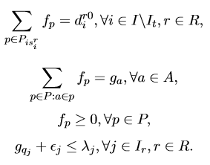
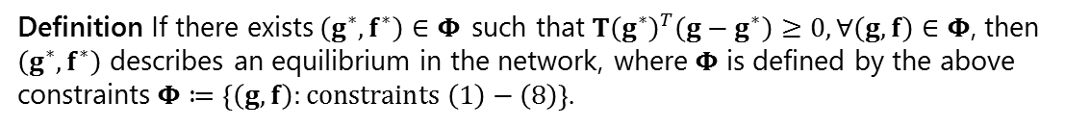
Interdependency Model Formulation
Interdependency function
(1)
Functional support
Resource support
Finite resource capacity
(2)
Initial disruption
(3)
Restoration
(4)
Flow conservation
(5)
(6)
Non-negativity
(7)
Resource capacity constraint
(8)
System equilibrium
Definition If there exists$\left(g^{∗},f^{∗}\right)∈Φ$ such that$T{\left(g^{∗}\right)}^{T}\left(g−g^{∗}\right)≥0,∀\left(g,f\right)∈Φ$, then $\left(g^{∗},f^{∗}\right)$ describes an equilibrium in the network, where$Φ$ is defined by the above constraints$Φ≔\left\{\left(g,f\right):constraints \left(1\right)−\left(8\right)\right\}$.
9
Notes:
As we mentioned, the model is essentially a network equilibrium where the facilities and population are network users. These formulations describe the model and we do not intend to go into details here.

Slide 10
Interdiction and Restoration
failed
functioning
Interdiction stage
Restoration stage
Notes:
Let’s then look at the interdiction-restoration problem in a graphical way. Each of these nodes represents a facility. Color green means the facility is functioning and red means failed. In the interdiction stage, we select some facilities as targets to interdict. The failure of these facilities will propagate in the infrastructure system due to interdependency. Then among all the disrupted facilities in the disruption aftermath, we select some of them to repair. With these facilities working, some others will also be functioning again.

Slide 11



Interdiction and Restoration
Stage | Decisions | Objective
Interdiction | Select facilities to interdict in the intact system | Maximize impact
Recovery | Select facilities to restore among the failed ones | Maximize restored social function
Objective
1st stage objective
2nd stage objective
Budget constraint
Social welfare constraint
Notes:
In the interdiction stage, the objective is to maximize the interdiction impact, and in the recovery stage, it is to maximize the restored social function. We put different weights to these two objectives and add them up as our final objective. There is a budget constraint for military operations. Moreover, we need to restore the final state social function to a certain level such that the basic need of population can be satisfied.

Slide 12
Solution Algorithm
Cutting Plane Algorithm
Implemented to solve for interdependency model equilibrium
Two-Stage GA
Solve the two-stage optimization
Based on Nguyen and Dupuis (1984)
Evaluate 1st stage decision based on the optimal 2nd stage decision
Notes:
We use a cutting plane algorithm to solve the system equilibrium for the interdependency model. This algorithm was based on the work of Nguyen and Dupuis in 1984. We will also skip the details. Then we use a two stage GA to solve the optimization.

Slide 13
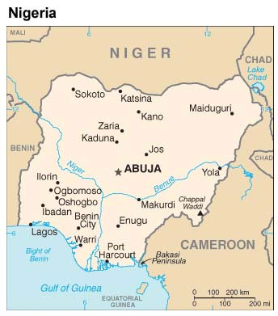
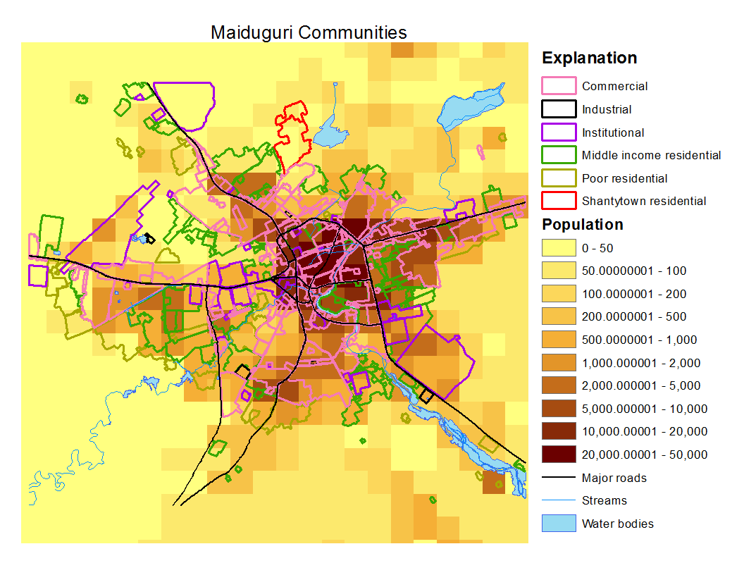
Case Study
City: Maiduguri, Nigeria
Total population of 1.2 million
Occasional natural disasters: flood, draught, etc.
Military events and terrorist attacks
Model setting
Seven layers of infrastructure networks and a community layer
20*20 grid transportation network
Uniform interdiction cost
Use three levels of restoration cost: low/moderate/high
Notes:
… We select this city for case study because it is a mid-size city suitable for research practice.

Slide 14
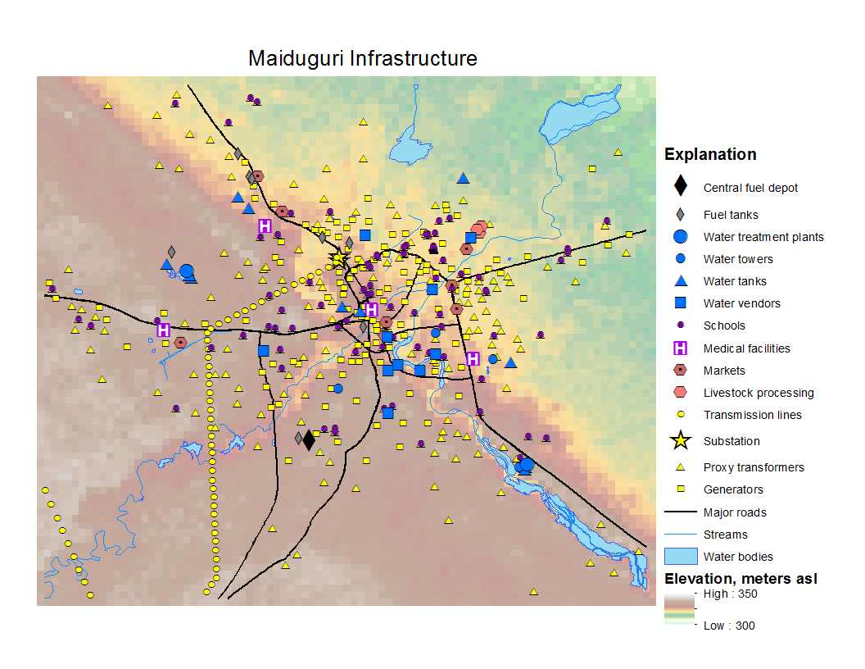
Case Study

Slide 15
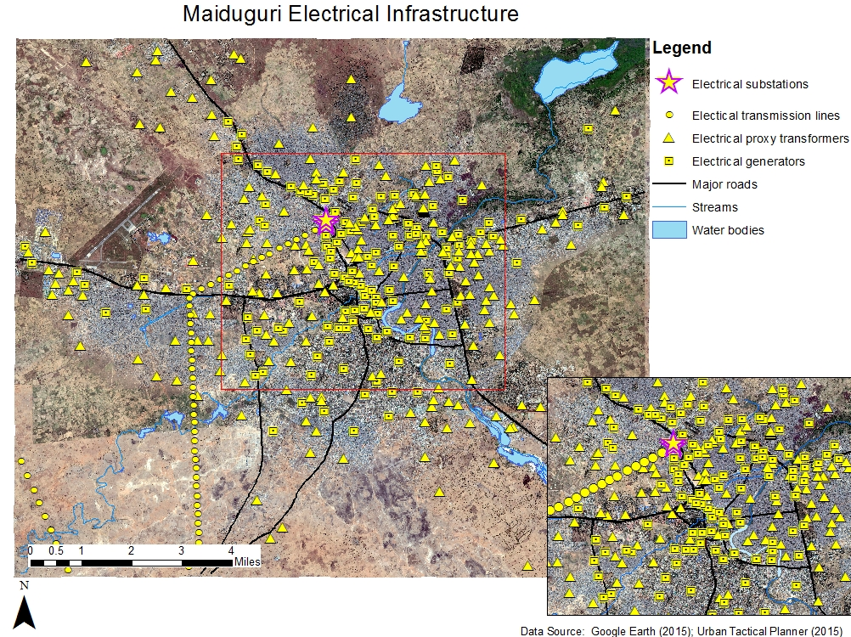
Case Study
Notes:
Power transmission – substation
Proxy transformers – triangles
Power generators – squares

Slide 16
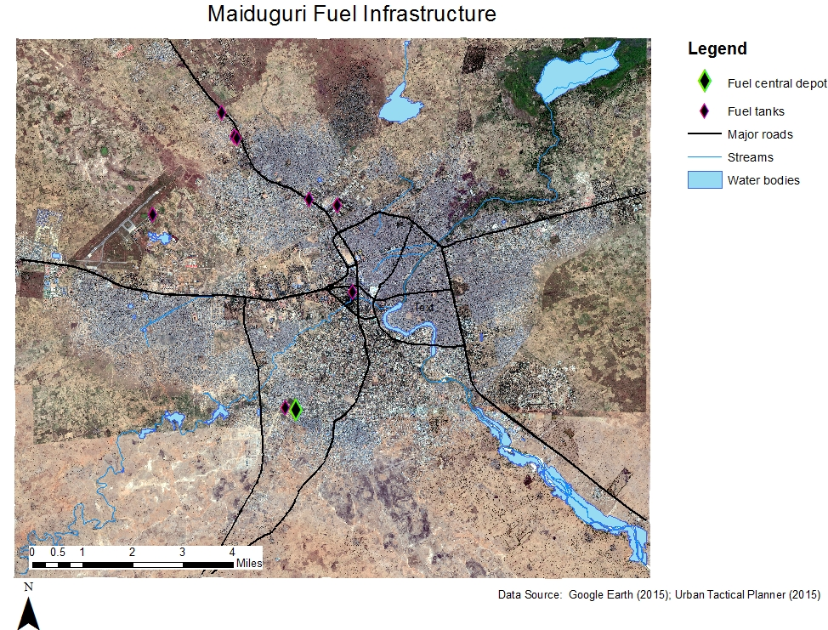
Case Study

Slide 17
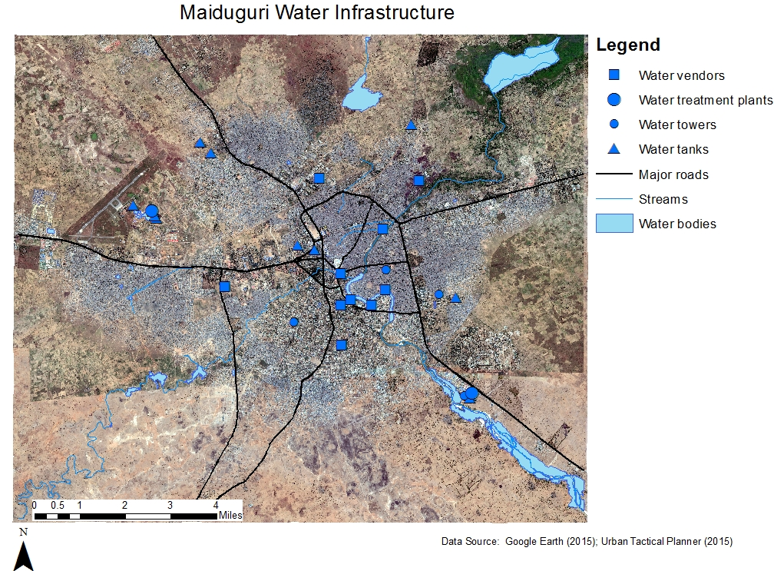
Case Study
Notes:
Water treatment plant – big circles - support by power substation
Water tanks (triangles, resource support) / towers (small circle, functional support)
Water vendors (squares)

Slide 18
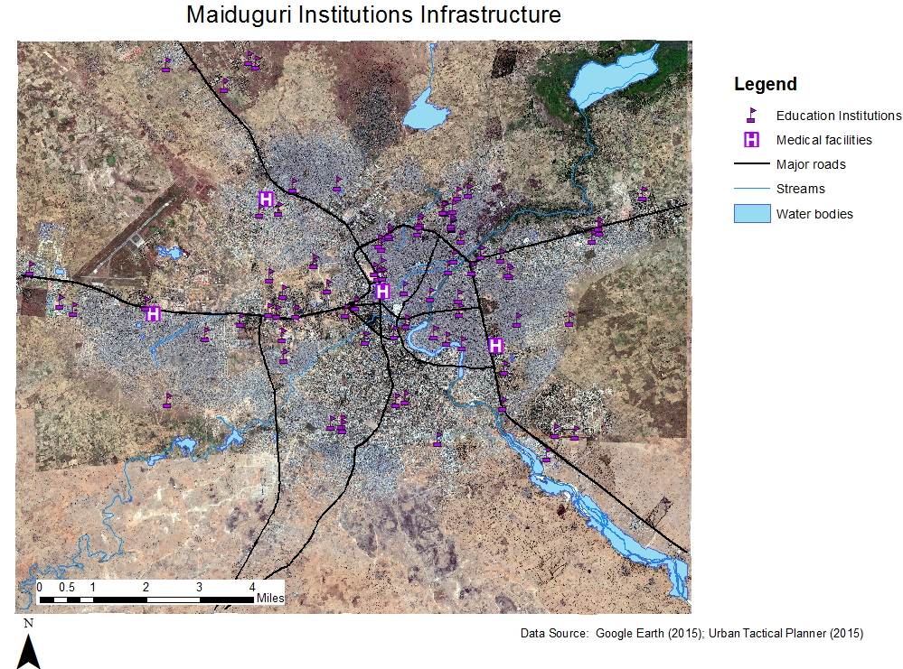
Case Study
Notes:
Institutions
4 hospitals (power supply from transformers and water supply via resource support from all available water facilities)

Slide 19
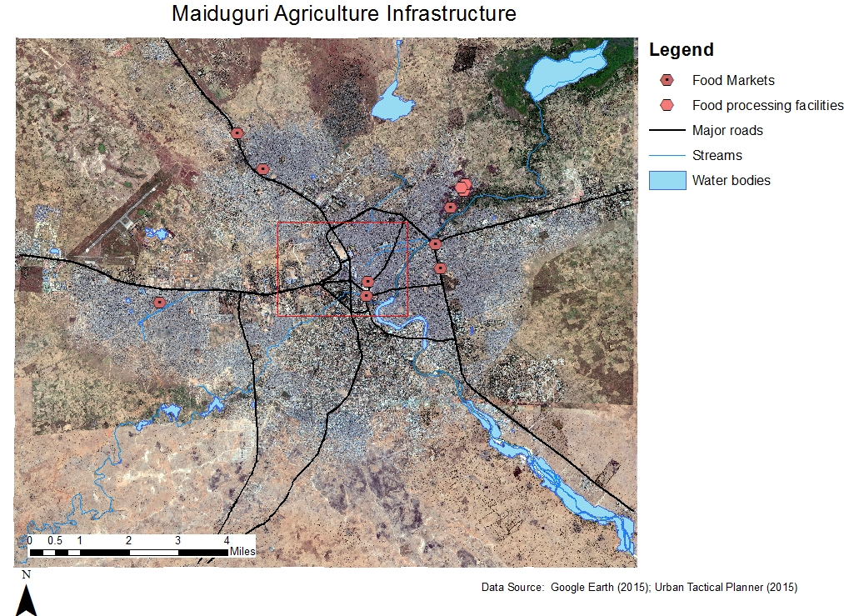
Case Study
Notes:
Three food processing factories, several food markets. Independent on other systems.

Slide 20
Case Study
Scenario 0: moderate budget
Interdiction decision
power transmission
fuel depot
Interdiction aftermath
entire power grid
fuel system
water system
hospitals
Impact on population
0% access to water
0% access to healthcare
100% access to food
Notes:
Scenario 0 is our benchmark case, where we have a moderate budget, such that we cannot afford to repair high restoration cost facilities such as fuel depot and power substation.

Slide 21
Case Study
Scenario 0: moderate budget
Restoration decision
power transmission
too costly to restore fuel depot: only recover one fuel tank
Restoration effectiveness
entire power grid
sufficient fuel supply
water vendors
hospitals
Impact on population
90% access to water
95% access to healthcare
92% access to food

Slide 22
Case Study
Scenario 1: low budget
Interdiction decision
fuel depot
Interdiction aftermath
fuel system
water vendors
hospitals
Impact on population
52% access to water
4% access to healthcare
89% access to food

Slide 23
Case Study
Scenario 1: low budget
Restoration decision
2 fuel tanks
Restoration effectiveness
sufficient fuel supply
water vendors
hospitals
Impact on population
90% access to water
96% access to healthcare
93% access to food

Slide 24
Case Study
Scenario 2: high budget
Interdiction decision
power transmission
fuel depot
3 food processing factories
Interdiction aftermath
power grid
fuel system
water system
hospitals
food system
Impact on population
0% access to water
0% access to healthcare
0% access to food

Slide 25
Case Study
Scenario 2: high budget
Restoration decision
power transmission
fuel depot
3 food processing factories
Restoration effectiveness
all system back to functioning
Impact on population
100% access to water
100% access to healthcare
100% access to food

Slide 26
Case Study
Scenario 3: moderate budget, no final state constraint and only consider first stage objective (terrorist attack)
Interdiction decision
power transmission
fuel depot
2 food processing factories
Interdiction aftermath
power grid
fuel system
water system
hospitals
food system
Impact on population
0% access to water
0% access to healthcare
5% access to food

Slide 27
Conclusion and Future Work
This study investigates the problem where a military force needs to help rebuild the damaged infrastructure system after its interdiction
The problem is modeled as a two-stage optimization, solved using GA
Interdiction/restoration actions are evaluated using an infrastructure interdependency model, solved in an embedded cutting plane algorithm
Case study on theoretical war-game scenarios reveals interesting results

Slide 28
Thank you!

