Slide 1
2015 INFORMS, Philadelphia Reliability of Interdependent Urban Infrastructure Network:
Failure Propagation and Consequential Social Impact
Presenting author: Liqun Lu
Co-author: Yanfeng Ouyang, Xin Wang
Nov 1st 2015
University of Illinois at Urbana-Champaign
Notes:
1

Slide 2
System of Infrastructure Systems
Modern urban infrastructure systems
Multiple networked sub-systems
Jointly functioning
High interdependency
Vulnerability to disruptions
Urban population
Great amount & density
Highly dependent on infrastructural system
Population behavior will be reshaped by disruptions
System disruptions
Natural disasters or human-induced actions
System cascading failure
Reduce system performance
Insufficient resource for population
Power
Transportation
Water
…
Community
Notes:
Eight systems that needs to be addressed eventually: water, electricity, commercial (agricultural food), roads, communication, social (healthcare, religion, emergency), and -- We may start with a few, and add more later.
Weighting system in Iraq, case study
Spatial resolution: City level
Metric (addition, multiplication)
Biweekly Thursday morning
Agenda, phone connection!

Slide 3
Objective of Study
System disruption propagation
Impact on population
Resource-providing facilities disrupted
Understand infrastructural interdependencies
Estimate population’s demand on resources
Commodity flow based on population reaction
Model cascading failure
Predict people’s resource-accessing behavior
Notes:
Eight systems that needs to be addressed eventually: water, electricity, commercial (agricultural food), roads, communication, social (healthcare, religion, emergency), and -- We may start with a few, and add more later.
Weighting system in Iraq, case study
Spatial resolution: City level
Metric (addition, multiplication)
Biweekly Thursday morning
Agenda, phone connection!

Slide 4
Failure Propagation Mechanism
Support Type | Realization | Example | Reason of failure | Failure
Functional Support | Direct physical infrastructural links | Power cable Water pipeline … | Failure of any one of the support facilities | Support failure
Resource Support | Commodity flow | Fuel delivered by transportation | Resource demand of facility not satisfied | Resource failure

Slide 5
Failure Propagation Mechanism
Example
(c)
(d)
Diesel tank
(a)
(b)
Diesel generator
(a)→(b): Initial disruption at diesel tank
(b)→(c): Resource failure at generator
(c)→(d): Support failure at pump
(b)→(e): Diesel generator seeks supply from another diesel tank
Water pump
Functional Support
(e)
Resource support

Slide 6
Objective of Study
System disruption propagation
Impact on population
Understand infrastructural interdependencies
Estimate population’s demand on resources
Model cascading failure
Predict people’s resource-access behavior
Notes:
Eight systems that needs to be addressed eventually: water, electricity, commercial (agricultural food), roads, communication, social (healthcare, religion, emergency), and -- We may start with a few, and add more later.
Weighting system in Iraq, case study
Spatial resolution: City level
Metric (addition, multiplication)
Biweekly Thursday morning
Agenda, phone connection!

Slide 7


Communities Behavior
Power
Functional Support
Water
Resource Support
Trans.
People access water at lower cost in a normal system

Slide 8
Communities Behavior
Power
Functional Support
Water
Resource Support
Trans.
Disruptions happen in the power system

Slide 9
Communities Behavior
Power
Functional Support
Water
Resource Support
Trans.
Some people will need to re-choose their resource locations

Slide 10
Communities Behavior
Power
Functional Support
Water
Resource Support
Trans.
The people will suffer if the access cost is too high

Slide 11
Communities Behavior
Power
Functional Support
Water
Resource Support
Trans.
Queueing and congestion also increases the access cost

Slide 12
System Equilibrium
Communities and facilities resource accessing behavior
Infrastructural interdependency
Cost of traversing each transportation link increases with flow
Queueing cost at resource supply increases with demand (M/M/1 queue)
Resource capacity of facilities are determined by their status
Queueing cost at a facility is affected by its status
Status of a facility is affected by others via interdependencies
User equilibrium problem
Each decision maker seeks the path and resource supply that require the minimum cost
All users are well-informed and rational
Link performance functions are sometimes dependent on flows on other links
System equilibrium a state where all the infrastructural interdependency constraints are met, and every user finds its best resource procurement strategy
Notes:
Eight systems that needs to be addressed eventually: water, electricity, commercial (agricultural food), roads, communication, social (healthcare, religion, emergency), and -- We may start with a few, and add more later.
Weighting system in Iraq, case study
Spatial resolution: City level
Metric (addition, multiplication)
Biweekly Thursday morning
Agenda, phone connection!

Slide 13
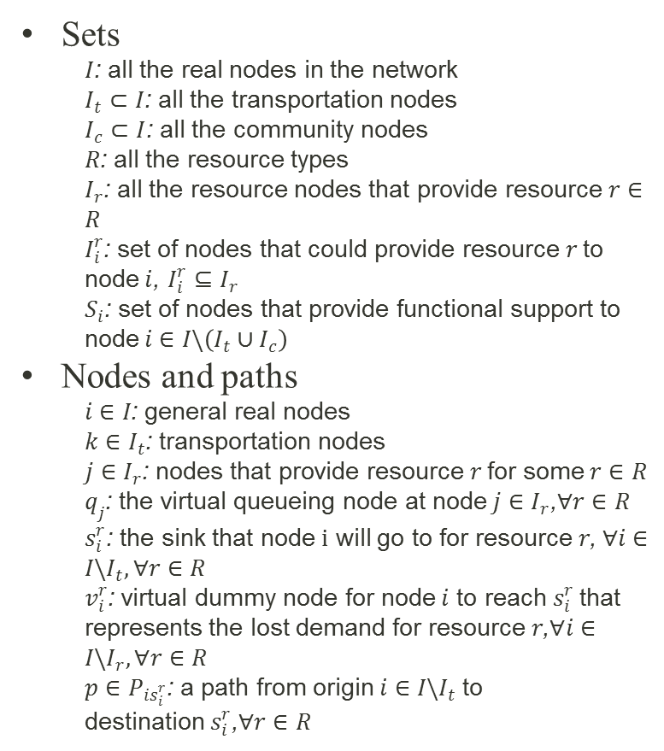
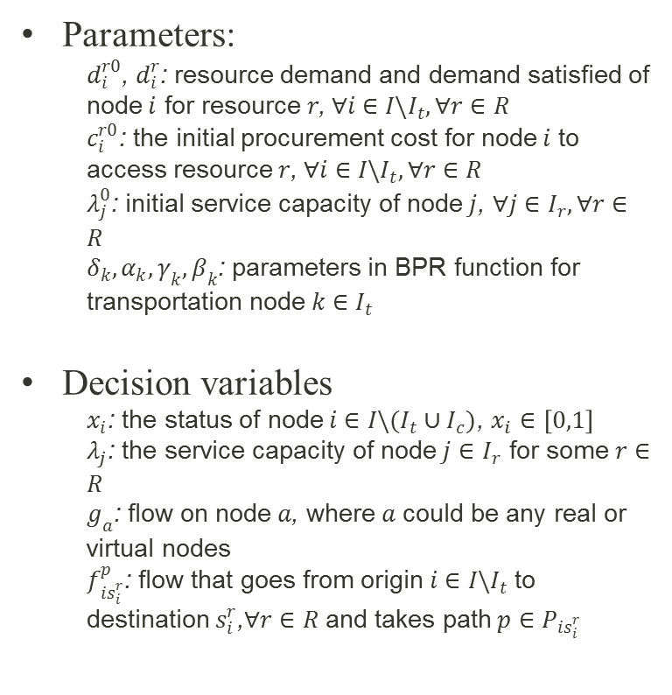
Problem Formulation
Sets
$I$: all the real nodes in the network
$I_{t}⊂I$: all the transportation nodes
$I_{c}⊂I$: all the community nodes
$R$: all the resource types
$I_{r}$: all the resource nodes that provide resource$r∈R$
$I_{i}^{r}$: set of nodes that could provide resource$r$ to node$i$, $I_{i}^{r}⊆I_{r}$
$S_{i}$: set of nodes that provide functional support to node$i∈I\backslash \left(I_{t}∪I_{c}\right)$
Nodes and paths
$i∈I$: general real nodes
$k∈I_{t}$: transportation nodes
$j∈I_{r}$: nodes that provide resource$r$ for some$r∈R$
$q_{j}$: the virtual queueing node at node$j∈I_{r}$,$∀r∈R$
$s_{i}^{r}$: the sink that node$i$ will go to for resource$r$, $∀i∈I\backslash I_{t}, ∀r∈R$
$v_{i}^{r}$: virtual dummy node for node$i$ to reach$s_{i}^{r}$that represents the lost demand for resource$r$,$∀i∈I\backslash I_{r},∀r∈R$
$p∈P_{is_{i}^{r}}$: a path from origin$i∈I\backslash I_{t}$ to destination$s_{i}^{r}$,$∀r∈R$
Parameters:
$d_{i}^{r0}$, $d_{i}^{r}$: resource demand and demand satisfied of node$i$ for resource$r$, $∀i∈I\backslash I_{t},∀r∈R$
$c_{i}^{r0}$: the initial procurement cost for node$i$ to access resource$r$, $∀i∈I\backslash I_{t}, ∀r∈R$
$λ_{j}^{0}$: initial service capacity of node$j$, $∀j∈I_{r}, ∀r∈R$
$δ_{k},α_{k},γ_{k},β_{k}$: parameters in BPR function for transportation node$k∈I_{t}$
Decision variables
$x_{i}$: the status of node$i∈I\backslash (I_{t}∪I_{c})$, $x_{i}∈\left[0,1\right]$
$λ_{j}$: the service capacity of node$j∈I_{r}$ for some$r∈R$
$g_{a}$: flow on node$a$, where$a$ could be any real or virtual nodes
$f_{is_{i}^{r}}^{p}$: flow that goes from origin $i∈I\backslash I_{t}$ to destination$s_{i}^{r}$,$∀r∈R$ and takes path$p∈P_{is_{i}^{r}}$
Notes:
Eight systems that needs to be addressed eventually: water, electricity, commercial (agricultural food), roads, communication, social (healthcare, religion, emergency), and -- We may start with a few, and add more later.
Weighting system in Iraq, case study
Spatial resolution: City level
Metric (addition, multiplication)
Biweekly Thursday morning
Agenda, phone connection!

Slide 14
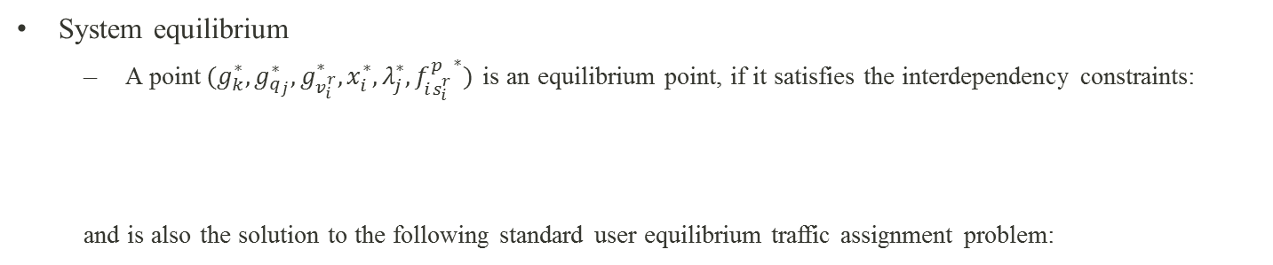
Problem Formulation
System equilibrium
A point$(g_{k}^{∗},g_{q_{j}}^{∗},g_{v_{i}^{r}}^{∗},x_{i}^{∗},λ_{j}^{∗},{f_{is_{i}^{r}}^{p}}^{∗})$ is an equilibrium point, if it satisfies the interdependency constraints:
and is also the solution to the following standard user equilibrium traffic assignment problem:
Objective function
Flow conservation constraints
Link performance functions
Non-negativity constraints
Notes:
Eight systems that needs to be addressed eventually: water, electricity, commercial (agricultural food), roads, communication, social (healthcare, religion, emergency), and -- We may start with a few, and add more later.
Weighting system in Iraq, case study
Spatial resolution: City level
Metric (addition, multiplication)
Biweekly Thursday morning
Agenda, phone connection!

Slide 15
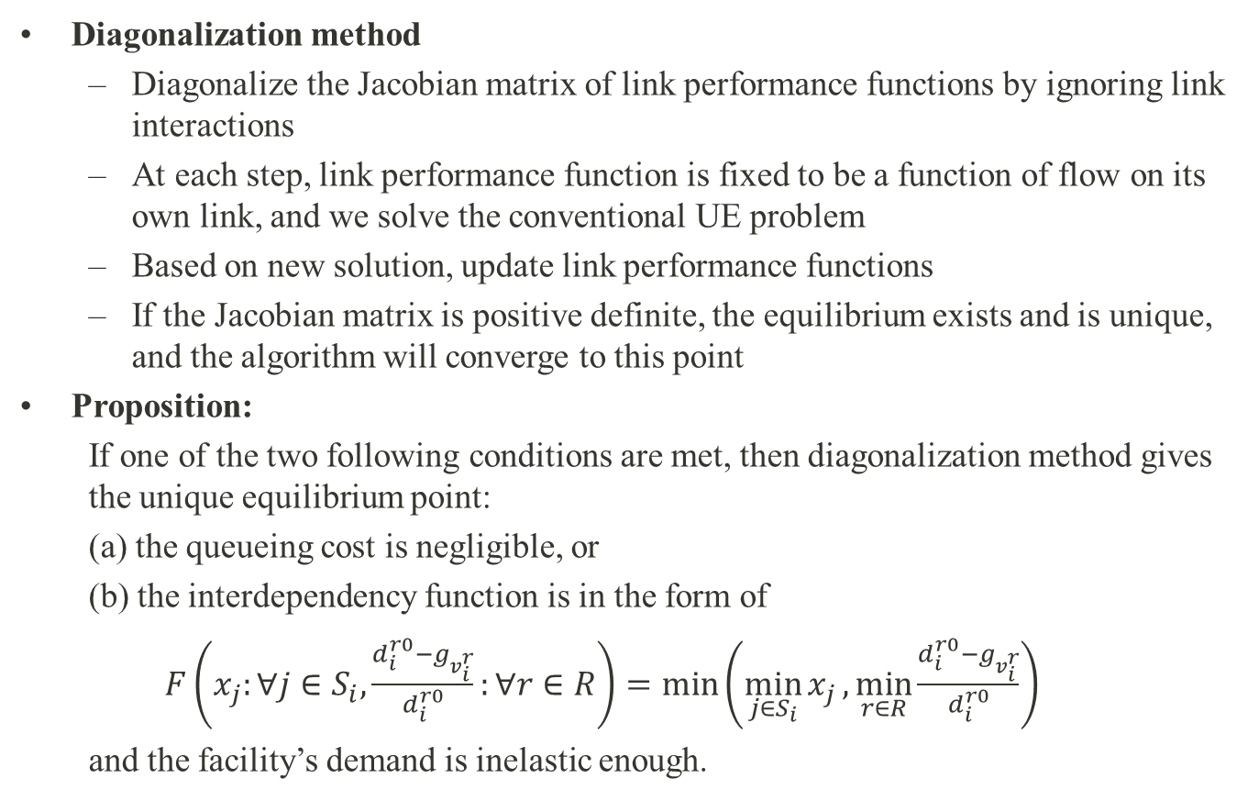
Solution Approach
Diagonalization method
Diagonalize the Jacobian matrix of link performance functions by ignoring link interactions
At each step, link performance function is fixed to be a function of flow on its own link, and we solve the conventional UE problem
Based on new solution, update link performance functions
If the Jacobian matrix is positive definite, the equilibrium exists and is unique, and the algorithm will converge to this point
Proposition:
If one of the two following conditions are met, then diagonalization method gives the unique equilibrium point:
(a) the queueing cost is negligible, or
(b) the interdependency function is in the form of
$F\left(x_{j}:∀j∈S_{i},\frac{d_{i}^{r0}−g_{v_{i}^{r}}}{d_{i}^{r0}}:∀r∈R\right)=min\left(\min_{j∈S_{i}}{x_{j}},\min_{r∈R}{\frac{d_{i}^{r0}−g_{v_{i}^{r}}}{d_{i}^{r0}}}\right)$
and the facility’s demand is inelastic enough.
Notes:
Eight systems that needs to be addressed eventually: water, electricity, commercial (agricultural food), roads, communication, social (healthcare, religion, emergency), and -- We may start with a few, and add more later.
Weighting system in Iraq, case study
Spatial resolution: City level
Metric (addition, multiplication)
Biweekly Thursday morning
Agenda, phone connection!

Slide 16
Network Implementation
Step 0. Initialization. Take system information and initial disruption as input. Regardless of resource failure, examine functional support and update facility status, until interdependency constraints are all met;
Step 1. Diagonalization. Update facility resource capacities based on status, conduct traffic assignment to obtain flow;
Step 2. Resource failure. Based on the flow, examine resource failure;
Step 3. Failure propagation Iteratively update status of each node until interdependency constraints are met for both resource failure and support failure;
Step 4. Stopping rule. If result converges or maximum iteration reached, terminate, otherwise, repeat Steps 1 to 3.
Notes:
Eight systems that needs to be addressed eventually: water, electricity, commercial (agricultural food), roads, communication, social (healthcare, religion, emergency), and -- We may start with a few, and add more later.
Weighting system in Iraq, case study
Spatial resolution: City level
Metric (addition, multiplication)
Biweekly Thursday morning
Agenda, phone connection!

Slide 17
Illustrative Measures for Social Impact Evaluation
Average access cost to certain resource
Sensitive measure that reflects minor changes in the system
Population that lost certain resource
Reflects the direct impact on the population
Number of failed facilities
Reflects the cascading failure among infrastructure facilities and help explain the changes in access cost and lost-resource population
Notes:
Eight systems that needs to be addressed eventually: water, electricity, commercial (agricultural food), roads, communication, social (healthcare, religion, emergency), and -- We may start with a few, and add more later.
Weighting system in Iraq, case study
Spatial resolution: City level
Metric (addition, multiplication)
Biweekly Thursday morning
Agenda, phone connection!

Slide 18
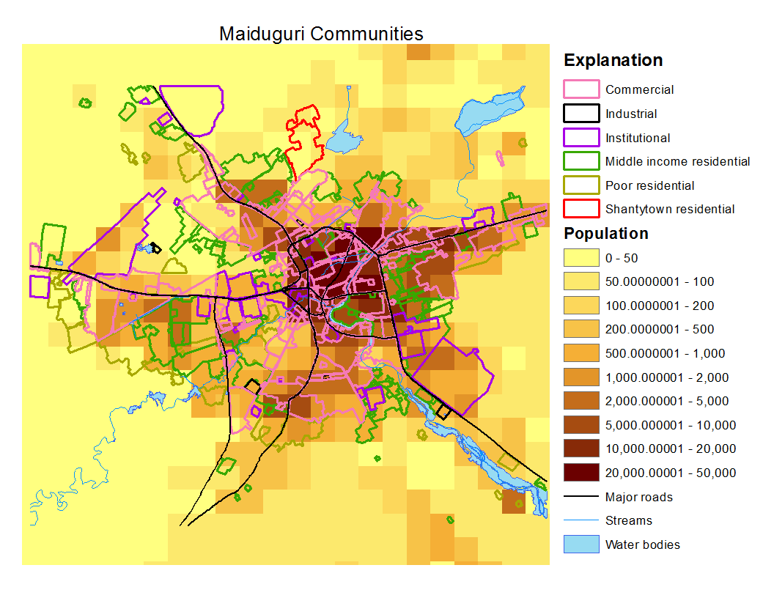
Numerical Examples
Case study: Maiduguri, Nigeria
Total population of 1.2 million
Occasional natural hazards: flood, draught, etc.
Overwhelming number of internally displaced persons (IDPs)
Military events and terrorist attacks threaten the people and infrastructure system
Setting
Seven layers of infrastructure networks and a community layer
Six categories of communities
Notes:
Eight systems that needs to be addressed eventually: water, electricity, commercial (agricultural food), roads, communication, social (healthcare, religion, emergency), and -- We may start with a few, and add more later.
Weighting system in Iraq, case study
Spatial resolution: City level
Metric (addition, multiplication)
Biweekly Thursday morning
Agenda, phone connection!

Slide 19
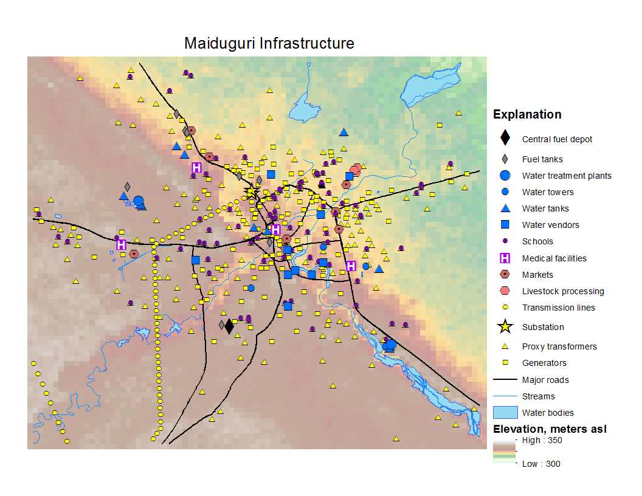
Numerical Examples
Notes:
Eight systems that needs to be addressed eventually: water, electricity, commercial (agricultural food), roads, communication, social (healthcare, religion, emergency), and -- We may start with a few, and add more later.
Weighting system in Iraq, case study
Spatial resolution: City level
Metric (addition, multiplication)
Biweekly Thursday morning
Agenda, phone connection!

Slide 20
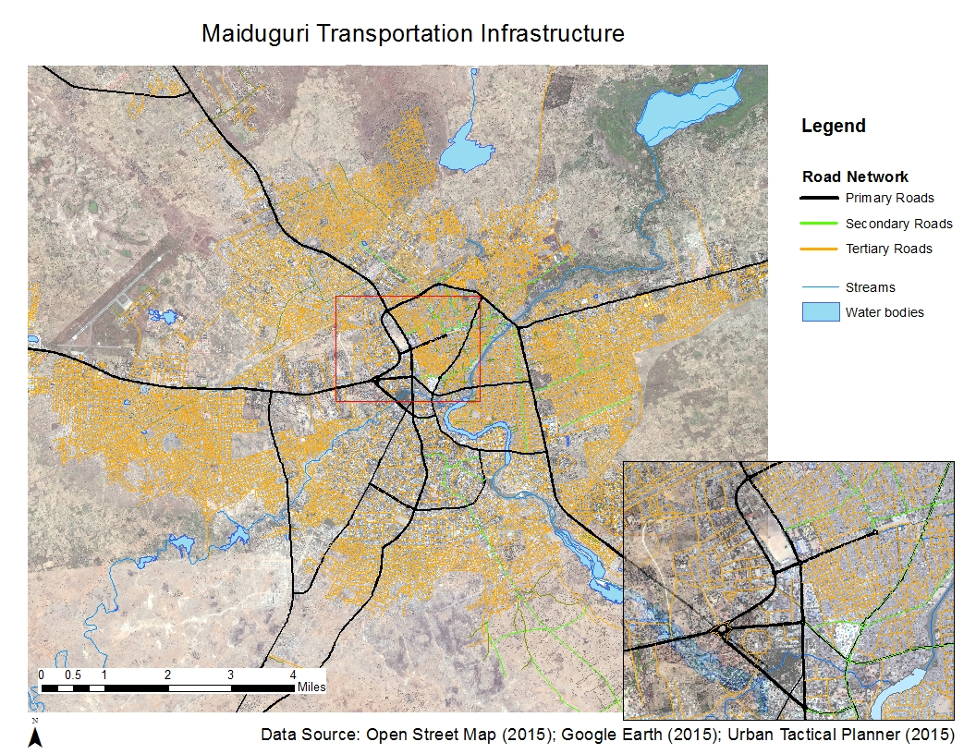
Numerical Examples
Notes:
Eight systems that needs to be addressed eventually: water, electricity, commercial (agricultural food), roads, communication, social (healthcare, religion, emergency), and -- We may start with a few, and add more later.
Weighting system in Iraq, case study
Spatial resolution: City level
Metric (addition, multiplication)
Biweekly Thursday morning
Agenda, phone connection!

Slide 21
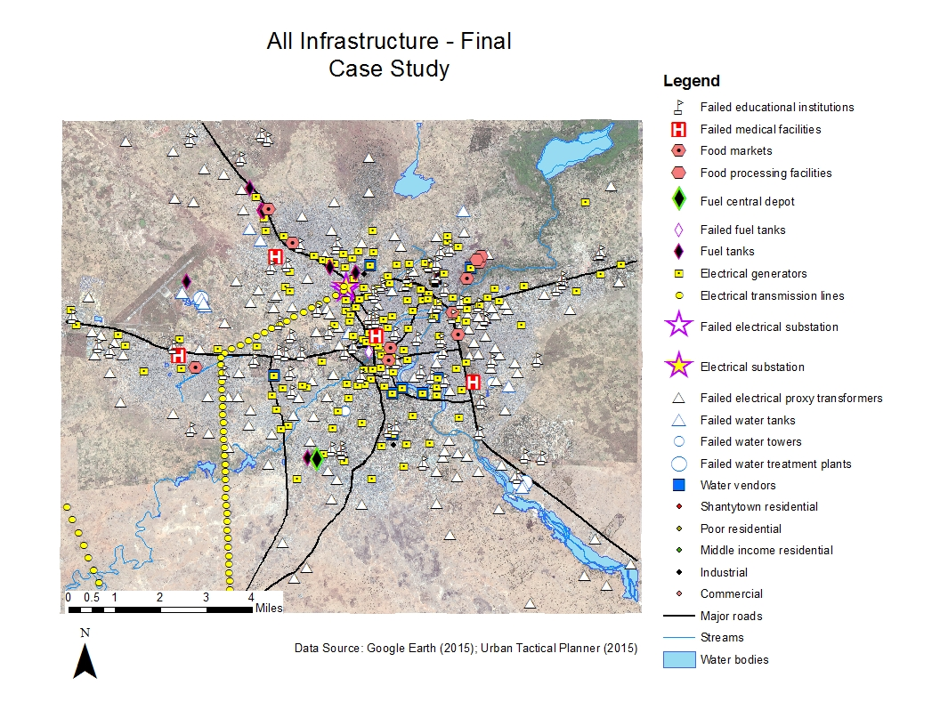
Numerical Examples
Initial disruption: power substation
Facility failures:
Water: 18/28
Power: 213/408
Food: 0/11
Fuel: 1/9
School: 84/84
Hospital: 4/4
Notes:
Eight systems that needs to be addressed eventually: water, electricity, commercial (agricultural food), roads, communication, social (healthcare, religion, emergency), and -- We may start with a few, and add more later.
Weighting system in Iraq, case study
Spatial resolution: City level
Metric (addition, multiplication)
Biweekly Thursday morning
Agenda, phone connection!

Slide 22
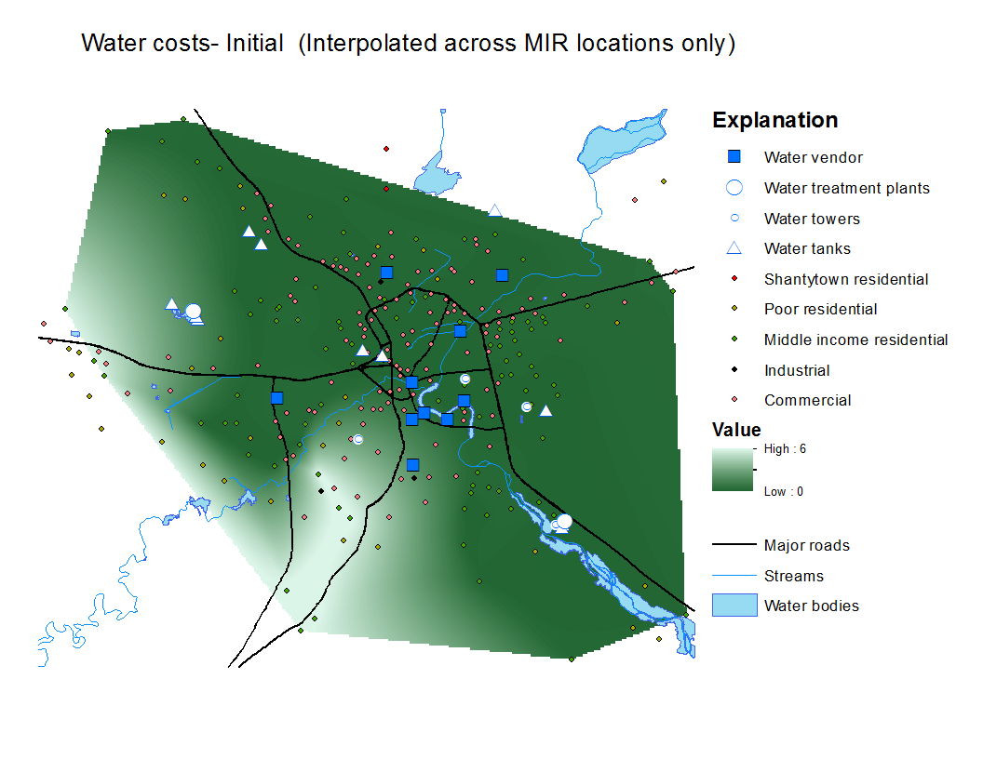
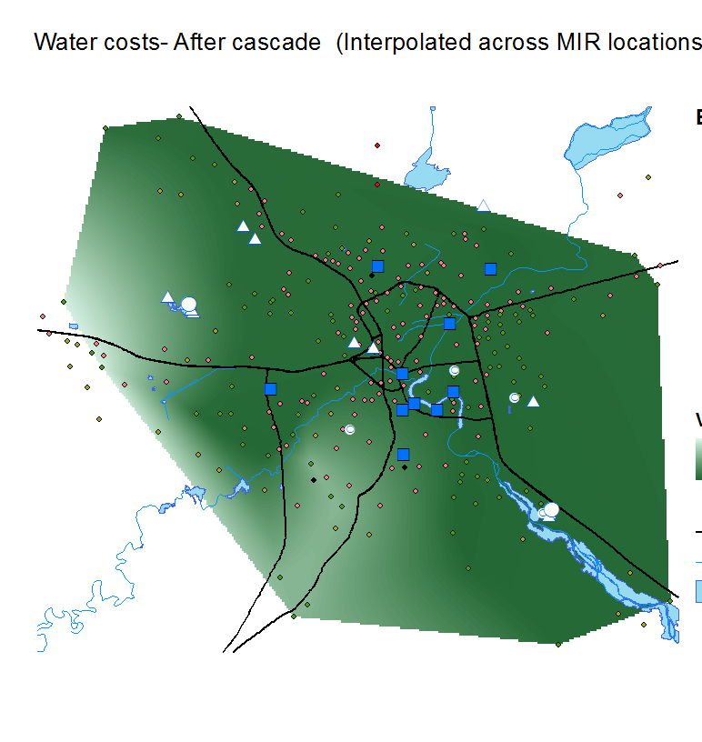
Numerical Examples
Water access cost is reduced by 14.7% after system failure, although 18 water nodes are lost
This is induced by the reduced traffic congestion as trip demand to schools and hospitals are gone
Water access cost – pre-cascading
Water access cost – post-cascading
Notes:
Eight systems that needs to be addressed eventually: water, electricity, commercial (agricultural food), roads, communication, social (healthcare, religion, emergency), and -- We may start with a few, and add more later.
Weighting system in Iraq, case study
Spatial resolution: City level
Metric (addition, multiplication)
Biweekly Thursday morning
Agenda, phone connection!

Slide 23
Numerical Examples
Tests are performed to check the sensitivity of the model to parameters
Road capacity change when failure happens
Road capacity | Food |  |  | Water
 | Access cost increment | Population lost resource | Failed facilities (total 11) | Access cost increment | Population lost resource | Failed facilities (total 28)
75% | 601.3% | 80.0% | 7 | 531.0% | 58.3% | 23
80% | 569.6% | 79.3% | 7 | 509.9% | 58.7% | 23
85% | 553.8% | 78.8% | 7 | 487.8% | 56.5% | 23
90% | 535.7% | 78.1% | 7 | 465.0% | 56.2% | 23
95% | -27.9% | 0.0% | 0 | 442.5% | 54.7% | 23
Case study (100%) | -35.7% | 0.0% | 0 | -14.7% | 0.0% | 18
Notes:
Eight systems that needs to be addressed eventually: water, electricity, commercial (agricultural food), roads, communication, social (healthcare, religion, emergency), and -- We may start with a few, and add more later.
Weighting system in Iraq, case study
Spatial resolution: City level
Metric (addition, multiplication)
Biweekly Thursday morning
Agenda, phone connection!

Slide 24
Numerical Examples
Different initial disruptions
Different initial failures usually have different outcomes
The results are difficult to predict and sometimes counter-intuitive
Initial disruptions | Food |  |  | Water
 | Access cost increment | Population lost resource | Failed facilities (total 11) | Access cost increment | Population lost resource | Failed facilities (total 28)
Case study (power subs.) | -35.7% | 0.0% | 0 | -14.7% | 0.0% | 18
fuel depot | 25.2% | 0.0% | 0 | 99.8% | 0.0% | 14
Water treatment plant | 3.0% | 0.0% | 0 | 6.5% | 0.0% | 7
Fuel depot and water treatment plant | 284.0% | 7.4% | 2 | 441.2% | 26.8% | 20
Notes:
Eight systems that needs to be addressed eventually: water, electricity, commercial (agricultural food), roads, communication, social (healthcare, religion, emergency), and -- We may start with a few, and add more later.
Weighting system in Iraq, case study
Spatial resolution: City level
Metric (addition, multiplication)
Biweekly Thursday morning
Agenda, phone connection!

Slide 25
Conclusions
This model demonstrates its capability to perform scenario-based “what-if” analysis on system disruption and cascading failure
A congested transportation network in normal scenario can lead to an extremely vulnerable urban system
Disruption happened at some “seemingly” critical infrastructures (such as an upstream water treatment plant) may not severely affect the entire system
The effect of multiple initial disruptions cause much worse results than single disruptions
Notes:
Eight systems that needs to be addressed eventually: water, electricity, commercial (agricultural food), roads, communication, social (healthcare, religion, emergency), and -- We may start with a few, and add more later.
Weighting system in Iraq, case study
Spatial resolution: City level
Metric (addition, multiplication)
Biweekly Thursday morning
Agenda, phone connection!

Slide 26
Thank you!
Questions?
Notes:
Eight systems that needs to be addressed eventually: water, electricity, commercial (agricultural food), roads, communication, social (healthcare, religion, emergency), and -- We may start with a few, and add more later.
Weighting system in Iraq, case study
Spatial resolution: City level
Metric (addition, multiplication)
Biweekly Thursday morning
Agenda, phone connection!

