Slide 1


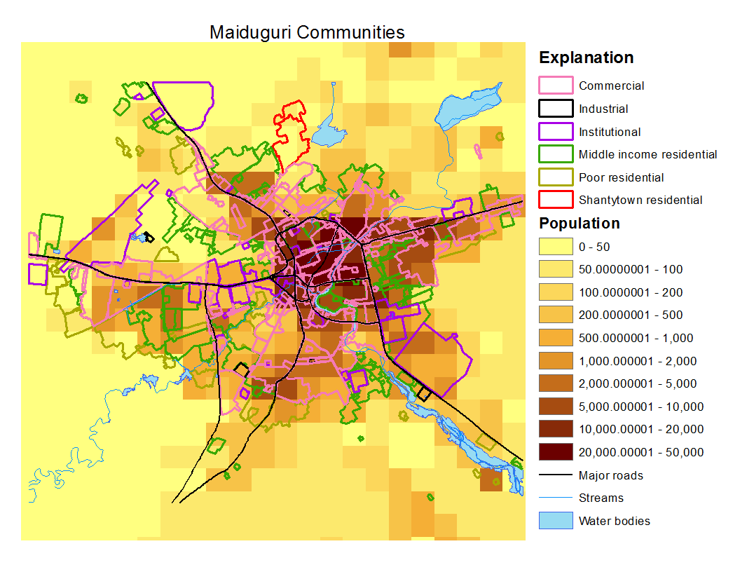
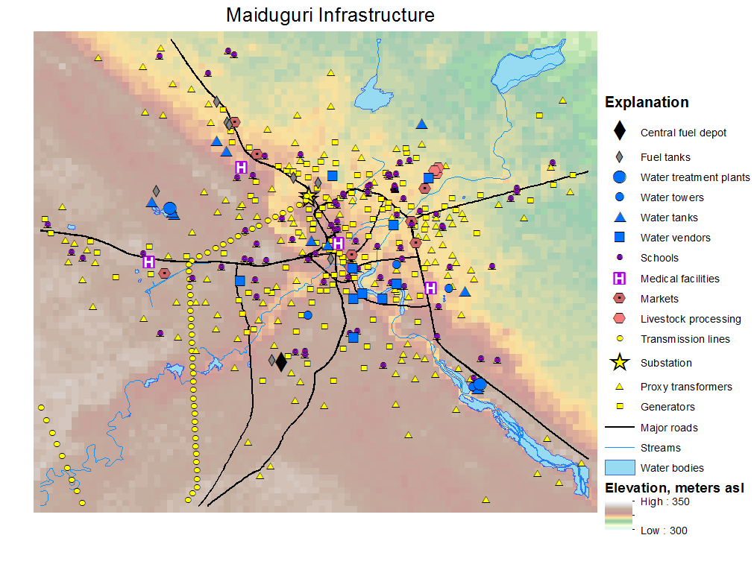
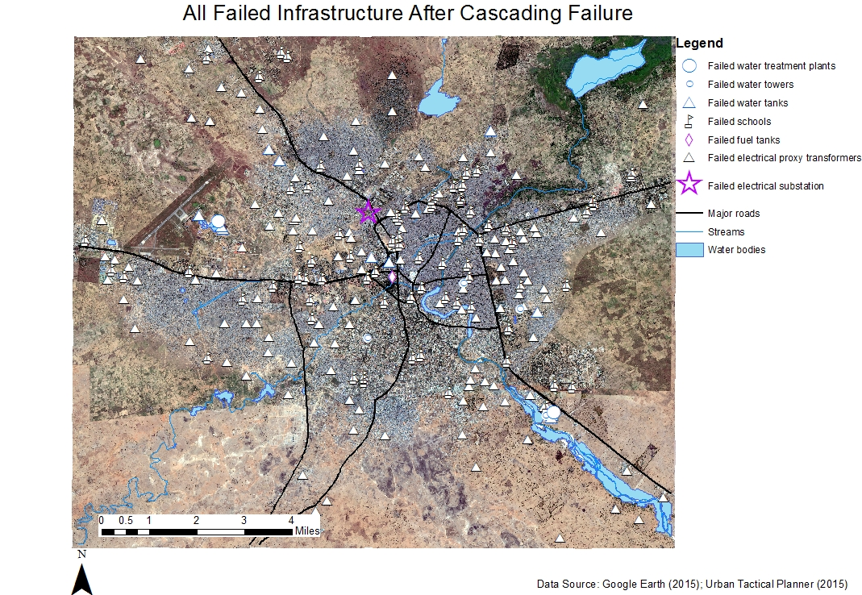
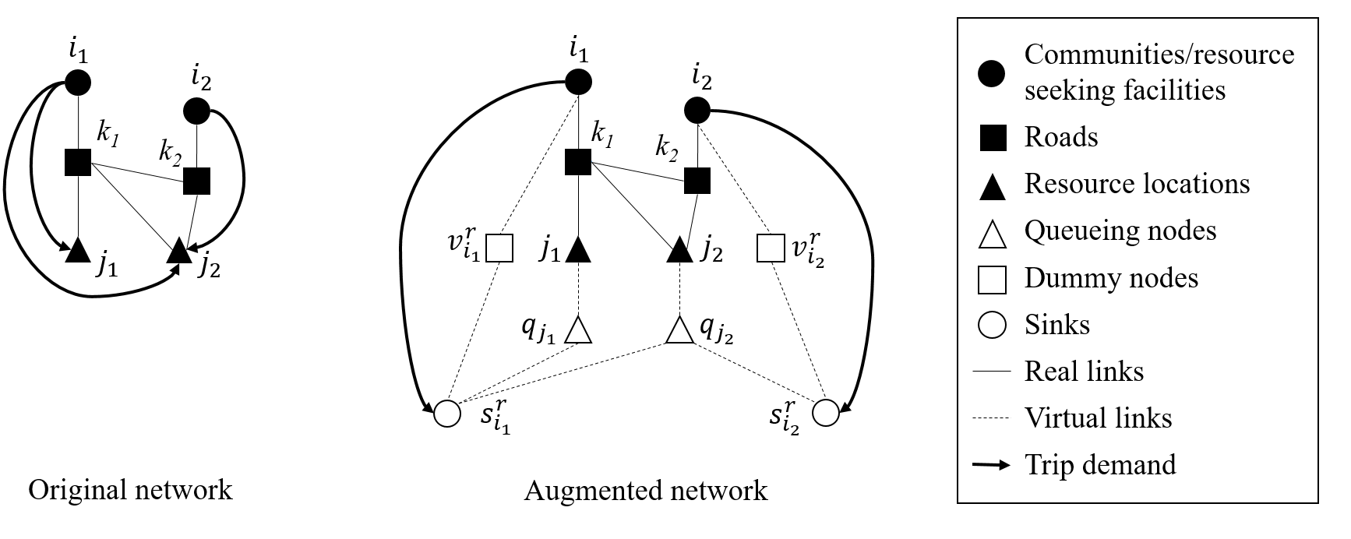
Vulnerability of Interdependent Urban Infrastructure Networks: Failure Propagation and Societal Impacts
Liqun Lu¹, Xin Wang², Yanfeng Ouyang¹, Natalie Myers³, Jeanne Roningen³, George Calfas³
[1. Department of Civil and Environmental Engineering, University of Illinois at Urbana-Champaign; 2. Department of Industrial and Systems Engineering, University of Wisconsin-Madison; 3. Construction Engineering Research Laboratory, US Army Engineer Research and Development Center]
Abstract
Methods
Results
Modern cities relies heavily on interdependent infrastructure systems
Disruptions often propagate within and across physical infrastructure networks and result in catastrophic consequences.
The reaction of population communities to disruptions may further transfer and aggravate the burden on surviving infrastructures
A game-theoretical equilibrium model is developed to investigate the mutual influence between the infrastructures and the communities
Multi-layer infrastructure network
Two types of infrastructure failure patterns
Network equilibrium is extended to address redistribution of resource demand
Societal impact is estimated based on communities’ resource demand loss, cost increase, and total infrastructure failure
A real-world case study on Maiduguri, Nigeria, is implemented to demonstrate the model and reveal insights
Infrastructural interdependency categorization
City: Maiduguri, Nigeria
Total population of 1.2 million
Occasional natural disasters: flood, draught, etc.
Overwhelming number of internally displaced persons (IDPs)
Military events and terrorist attacks threaten the people and infrastructure
Model setting
Seven layers of infrastructure networks and a community layer
Six categories of communities
Case Study
Disruption at the power substation
Support Type | Realization | Example | Reason of failure | Failure
Functional Support | Direct physical infrastructural links | Power cable Water pipeline … | Failure of any one of the support facilities | Support failure
Resource Support | Commodity flow | Fuel delivered via transportation | Resource access cost becomes too high | Resource failure
Facility/Community resource accessing behavior
Resource users travel through transportation network to acquire resource
The cost of traversing each transportation link increases with flow
Limited resource supply also increases the difficulty for resource procurement
The demand decreases with procurement cost
Augmented network representation
The problem can be converted into an equivalent Wardrop equilibrium problem with link interactions
Background
Modern urban infrastructure systems
Multiple networked systems
Jointly functioning
High interdependency
Vulnerability to disruptions
Urban population
Great amount & density
Highly dependent on infrastructural system
Population behavior will be reshaped by disruptions
System disruptions
Natural disasters or human-induced actions
System cascading failure
Reduce system performance
Insufficient resource for population
Power
Transportation
Result summary
Failed facilities:
water: 17.5/28
food: 0.0/11
education: 84.0/84
healthcare: 4.0/4
Problem formulation
Different scenarios | Food |  |  | Water
 | Access cost increment | Population lost resource | Failed facilities (total 11) | Access cost increment | Population lost resource | Failed facilities (total 28)
0: Case Study | -7% | 0.0% | 0.0 | 458% | 4.3% | 17.5
1: No Queueing Cost | -36% | 0.0% | 0.0 | 0.5% | 0.0% | 18.0
2: Moderate resource cap. | -49% | 0.0% | 0.0 | -25% | 0.0% | 17.5
3: High resource cap. | -54% | 0.0% | 0.0 | -35% | 0.0% | 17.5
4: Init. Water | -27% | 0.0% | 0.0 | 20% | 2.9% | 9.3
5: Init. Fuel | 22% | 1.3% | 0.5 | 157% | 5.9% | 10.6
6: Water and Fuel | -2% | 0.0% | 0.3 | 860% | 8.7% | 16.2
Water
Interdependency function
(1)
…
Finite resource capacity
Functional support
Resource support
(2)
Initial disruption
(3)
Community
Nash equilibrium
(4)
(5)
(6)
(7)
Conclusions
Objectives
(8)
A holistic mathematical model is proposed to evaluate the vulnerability of an urban infrastructure system against the threats of cascading failures
The infrastructure systems are modeled as a multi-layered network, where each functioning infrastructure unit is modeled as a node
Two types of infrastructure failure mechanisms are modeled to estimate the cascading failure
A network equilibrium model incorporating queueing and congestion is formulated, and mathematical proofs for equilibrium existence and uniqueness is shown
A diagonalization algorithm is developed to solve the equilibrium and to compute societal impacts, with the discussion on the convergence of the algorithm
Through a case study on Maiduguri, many interesting insights are observed
A system with greater resource capacity is more resilient to disruptions
Disruption happening at some “seemingly” critical infrastructures may not severely affect the entire system
Maintaining the functionality of some infrastructures may not benefit the society
(9)
Generalize various types of interdependencies among infrastructures
Estimate entangled system failure and equilibrium community behavior
Evaluate the cascading propagation of disruptions and the consequential societal impacts
(10)
System equilibrium
(11)
(12)
System disruption propagation
Impact on population
Equilibrium analysis and solution approach
Resource-providing facilities disrupted
Proposition 1. There exists a unique equilibrium if:
(1) the interdependency function is continuous, concave, and non-decreasing, and
(2) the demand-loss penalty is monotonically increasing.
Proposition 2. The diagonalization method gives the unique equilibrium point with guaranteed global convergence if either one of the following two conditions is satisfied:
i) The facility status is not sensitive to resource failure;
ii) The resource demand is inelastic enough, such that the demand-loss penalty is highly sensitive to the lost demand
Understand infrastructural interdependencies
Estimate population’s demand on resources
Model cascading failure
Commodity flow based on population reaction
Predict people’s resource-access behavior

